Slide 1

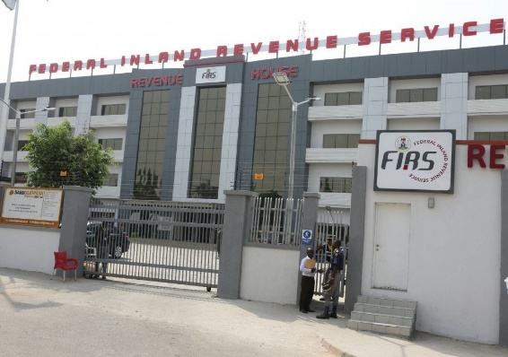
CRITICAL REVIEW OF FIRS’ LEGAL AND OPERATIONAL CAPACITY TO CURB ILLICIT FINANCIAL FLOWS (IFFs)

Slide 2

01
Introduction
Conceptual Framework
02
Key Issues in IFF
03
04
Impact of IFF
CONTENTS
05
Stakeholders in fighting IFF
06
Sources of IFF
07
Measures in curbing IFF
08
04
Next Steps for FIRS

Slide 3
Introduction
Cross-border crimes such as theft, bribery, corruption, human trafficking and drug peddling have continuously posed as a huge challenge for global development and growth. These includes illicit financial flows (IFF) which has become widespread and highly sophisticated. In Africa, the effects of cross border crimes has greatly brought about large revenue losses. According to the Report of the High Level Panel on Illicit Financial Flows, Africa is estimated to be losing more than $50 billion annually in Illicit Financial Flows (IFF).
In Nigeria, the loss of government revenue has negatively impacted sustainable development growth particularly in areas of infrastructure, national security and external relations. Nigeria’s losses through IFF activities amounted to nearly $10bn. Our international engagements have suffered considerable harm due to digital crimes which has impacted adversely on financial sectors, private companies, individuals and the general social system.

Slide 4
02. Conceptual Framework
To be clear, IFF is a reference to a wide range of cross-border economic and financial flows in circumstances considered illegal to the extent that they are contrary to extant laws, customs or prevailing morale of the society. It comprises of two elements, namely: illegal capital (flow of capital originating from the theft of state assets and the proceeds of crime and tax evasion), and legal capital (flow of the proceeds of aggressive tax planning and avoidance, or other regulatory abuses).
For us in Nigeria, Corruption is the biggest enabler of IFF as it transverses both legal and illegal flows. It has eaten deep into our system and adversely weakened our institutions and regulations. For instance, the existence of tax havens created mainly to exploit differences in tax processes across jurisdictions has also enabled IFF globally.
What is IFF?

Slide 5
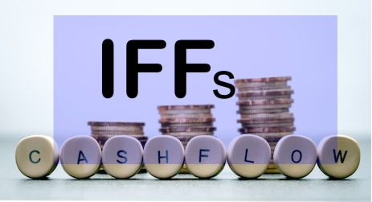
03. IFF: Conceptual Framework (Contd.)
who perpetuates IFF?
Private actors (individuals, domestic businesses and multinational companies including professional advisers – tax, legal, accounting, etc.) committing tax and other regulatory abuse;
Public office holders (politically exposed persons (PEP) or persons in public employment); and
Criminal groups (a term used here to indicate those motivated primarily by the proceeds of crime, and those using crime to fund social or political agenda, including terrorism)

Slide 6
Key Issues in IFF
1
2
3
Digital Illicit Financial Flows
One key area of concern is the effect of digital IFF on the concept of Permanent establishment. By virtue of Article 5 of the Nigerian Model Tax Conventions, for a company to be taxed in Nigeria it must have a physical nexus, that is a location where its business is being carried out in Nigeria and for the income to be taxable, it would be such that is attributable to such physical presence . Where therefore, it is possible to trade without establishing physical presence, which means that income will not be taxable and shall contrast the fact that such entity has made income from Nigeria.
Base Erosion and Profit Shifting (BEPS) Practices
Multinational Corporations operating through several entities engage in profit shifting in violation of the transfer pricing arm’s length principle. According to the OECD Centre for Tax Policy and Administration, ‘base erosion and profit shifting’ (BEPS) “refers to tax planning strategies that exploit loopholes in tax rules to make profits disappear for tax purposes or to shift profits to locations where there is little or no real activity but where they are lightly taxed, resulting in little or no overall corporate tax being paid.” BEPS includes instances where the interaction of different tax rules leads to double non-taxation or less than single taxation.
Transparent Exchange of Information
The advent of the global digital economy has opened the pathway for cross border international trade, unfortunately this comes with negative possibilities. Countries have resorted to exchange of information in tax matters. However, the efficiency of this tax co-operation and differences in legal framework has made IFF prevalent in cross border activities. Where transparent information is missing, taxpayers who have access to cross-border transactions can also have access to greater tax evasion and avoidance possibilities than taxpayers operating within the domestic market.

Slide 7
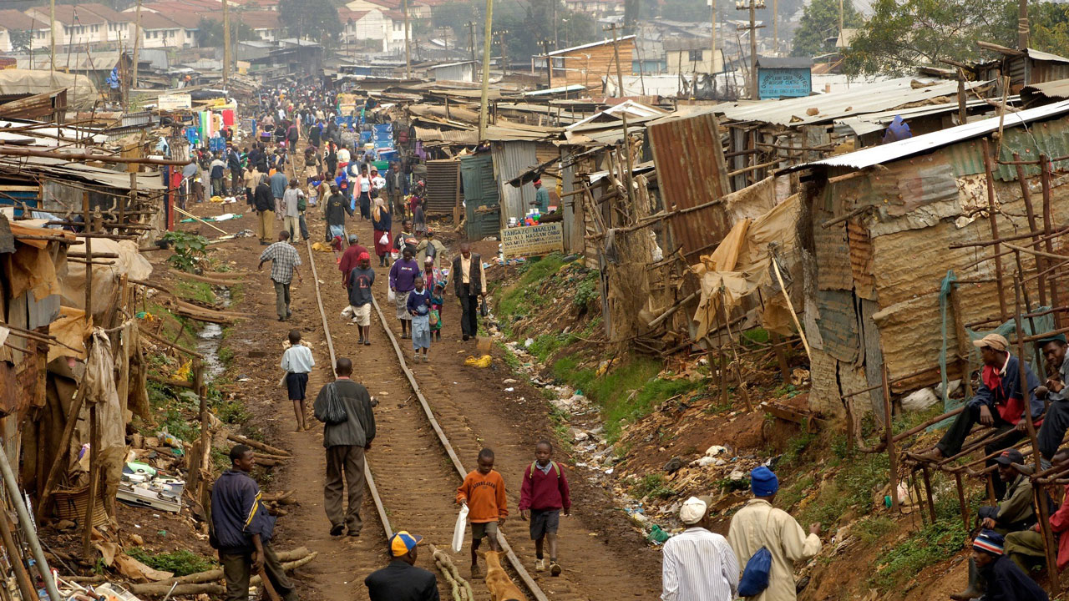
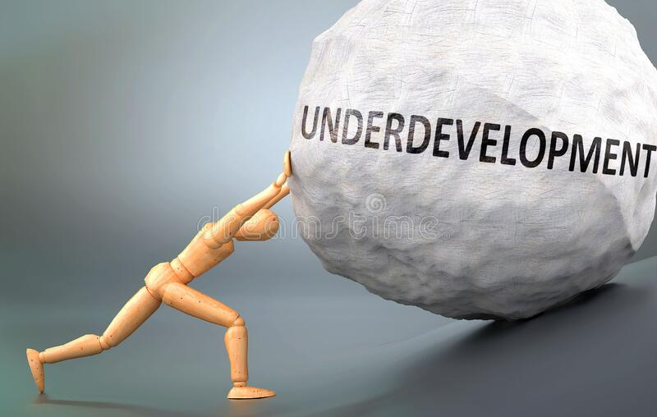

03. Impact of IFF
what’s the impact of IFF
Loss of revenue accruing to the
Government
Underdevelopment
Infrastructure Deficit
Poverty
Diseases
Unemployment
Insecurity
Inability to meet other SDGs

Slide 8
IFF
Tax Officials and Professionals
MDAs
Prosecutors
Legislators
Whistle blowers etc.
CSOs/NGOs etc.
Other Professionals
who should fight IFF?
Anyone can fight IFF including:
Captains of Industries
MDAs
Legislators
Prosecutors
Financial gatekeepers
Tax officials
Anti-corruption agencies
Whistle blowers, etc

Slide 9


Sources of IFF
Corruption
Trade Mis-invoicing
Transfer Pricing
Tax treaty abuse
Investment manipulation
Abuse of contractual clauses and obligations
Theft, bribery, criminal activities and tax evasion and abuse generally .

Slide 10


Measures Necessary for Curbing IFF
Transparency and Exchange of Information:
In September 2020, FIRS launched the Automatic Exchange of Information portal for commencement of exchange of information. It improves transparency through access to valuable tax information from other tax jurisdictions required for effective tax administration, to also address Transfer Pricing, Thin Capitalization and other tax avoidance or evasion mechanisms, thereby helping to combat tax revenue leakage from developing countries.
Robust Implementation
of BEPS
In 2017, Nigeria constituted the National BEPS Implementation Committee, which was an inter-agency committee and which included representatives of the private sector, to review and domesticate the BEPS outcome into policies in Nigeria. This assignment culminated into the issuance of several Regulations, Guidelines and amendment to the tax laws (through some of the provisions in Finance Act 2019) to combat those abuses..
Taxation of the Digital Economy
As preliminary measures, Nigeria introduced the Significant Economic Presence (SEP) rules through an amendment to Section 13 of CITA and the release of the Companies Income Tax (Significant Economic Presence) Order 2020. This provision is meant to tax companies from non-treaty countries deriving business income from Nigeria through digital means and without having a physical presence in Nigeria.

Slide 11


Measures Necessary for Curbing IFF
Robust Tax Treaty strategy
The FIRS, working with the Federal Ministry of Finance, Budget and National Planning, has produced a tax treaty model for Nigeria, which reflects the tax policy position enshrined with the best of UN, ATAF and OECD models adapted to the unique economic need of Nigeria.
One key feature of the Nigeria’s treaty model is the inclusion of a special provision on exploitation and exploration of natural resources to ensure that Nigeria derived maximum benefits from its natural resources. The Nigerian treaty model and its potential to effectively combat IFF have been commended by the World Bank and IMF team that have visited Nigeria in recent times.
Ensuring Transparency
Adopting instruments like:
Transfer pricing rules
Common Reporting Standard, Country by Country Regulation, Exchange of Information
Beneficial Ownership, etc
Incentivize Compliance by the MNCs
Appropriate incentive have been provided for multinational companies as motivation to comply with measures to diminish IFFs. Policies aimed at ensuring tax certainty introduced these incentives that promote voluntary tax
Adoption of Technology
Tax ProMax
Digital Economy Compliance Tool for VAT: To collect VAT from cross boarder transactions through the non residence suppliers.

Slide 12
Next Steps for FIRS
Introduction of beneficial ownership legislation to help focus attention on the beneficial ownership regimes. Ensuring transparency about beneficial ownership (the ultimate ownership and control of companies), e.g. through the obligation to maintain up to date information on the verified beneficial ownership of all legal persons and arrangements. These can make major contributions to combatting illicit financial flows.
We strengthen tax authorities starting with the FIRS especially in areas of capacity development for our officers in Transfer pricing units, international tax unit and international tax department and investigation officers for investigating and prosecuting tax evasion and other tax crimes, and in some cases, money laundering. Also strengthening collaboration with other regulators and agencies to gain relevant information where necessary.
The FIRS shall continue to deploy proper CbCR and CRS correspondences for transparent information. We have to continually ensure access to transparent information and also the right to obtain it.
Full automation of tax administration

Slide 13
THANK YOU

