Slide 1


Nigerian Financial Intelligence Unit (NFIU)
No. 12, Ibrahim Taiwo Street, Aso Villa, Abuja, FCT. www.nfiu.gov.ng
Effect of Corruption, Fraud and Money Laundering
on Nigeria and its Financial System.
PRESENTED AT SIXTH ANNUAL CONFERENCE ON FINANCIAL CRIME, CROSS-BORDER CRIME AND
ELECTORAL FRAUD
Effect of Corruption, Fraud and Money Laundering on Nigeria and its Financial System.

Slide 2


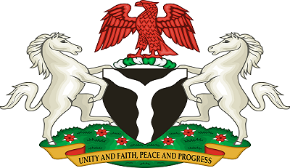
OUTLINE OF PRESENTATION
Introduction
01
Money Laundering and its Predicate Offences
02
Effect of Money Laundering on the Financial System
03
How to reduce the effects of Money Laundering on the Financial System
04
Conclusions and Recommendations
05
Effect of Corruption, Fraud and Money Laundering on Nigeria and its Financial System.

Slide 3
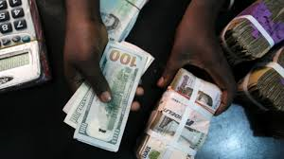
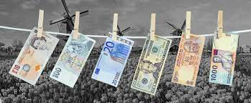
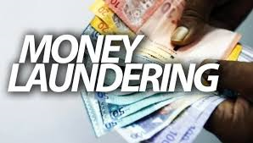
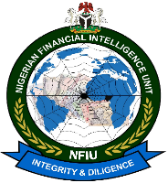
Introduction
The Financial Action Task Force on Money Laundering (FATF), which is recognized as the international standard setter for anti-money laundering (AML) efforts, defines the term “Money Laundering” succinctly as “the processing of criminal proceeds to disguise their illegal origin” in order to “legitimize” the ill-gotten gains of crime. This process is of critical importance, as it enables the criminal to enjoy these profits without jeopardising their source.
As money laundering is a consequence of almost all profit generating crime, it can occur practically anywhere in the world. Generally, money launderers tend to seek out countries or sectors in which there is a low risk of detection due to weak or ineffective anti-money laundering programmes. Because the objective of money laundering is to get the illegal funds back to the individual who generated them, launderers usually prefer to move funds through stable financial systems.
Effect of Corruption, Fraud and Money Laundering on Nigeria and its Financial System.

Slide 4
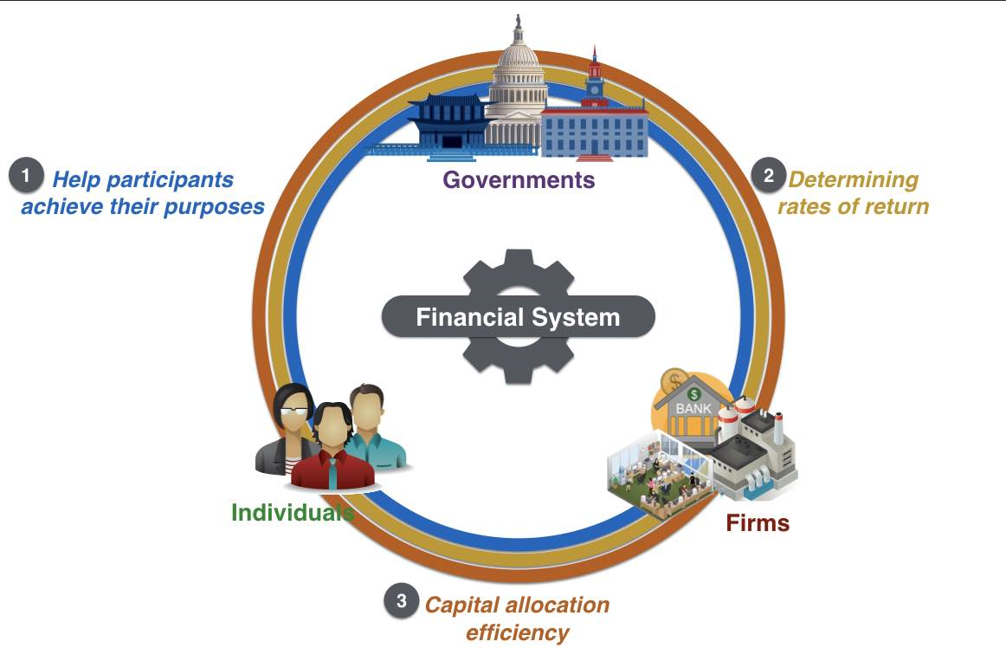

Introduction
“The financial system is defined as the institutional mechanism established by society to produce and deliver financial services and allocated resources, consisting of the business firms supplying financial services, the customers of the financial service firms, and government regulatory authorities that enforce the rules prevailing with in the financial sector” Rose, P S. & Fraser, D R. & Kolari, J. W. (1993).
Financial System refers to the system which comprises of country’s financial institutions, financial markets, financial instrument and financial services. It is a set of institutions, such as Banks, insurance companies, and stock exchanges, that permit the exchange of funds. A financial system exist on firm, regional, and global levels. (Sreekanth R. K., 2007)
Effect of Corruption, Fraud and Money Laundering on Nigeria and its Financial System.

Slide 5
Money Laundering - Predicate Offences
A “predicate offence” is an offence whose proceeds may become the subject of any of the money laundering offences established under the Article 6 of organized Crime Convention.
Bribery/Corruption
Kidnapping for Ransom
Tax Crime
Fraud
Human Trafficking
Oil Bunkery
Forgery/ Counterfeiting
Environmental Crime
Piracy
Blackmail and Extortion
Sexual Exploitation
Smuggling
Robery and Theft
Cybercrime
Drug Trafficking
Effect of Corruption, Fraud and Money Laundering on Nigeria and its Financial System.

Slide 6
Money Laundering and Financial System
Money Laundering Process
Placement Stage, the money launderer introduces his illegal profits into the financial system using different methods
Layering Stage, the launderer engages in a series of conversions or movements of the funds to distance them from their source.
Integration Stage, the funds re-enter the legitimate economy by investing the funds into real estate, luxury assets, or business ventures,etc
Arms Proliferation
and Financing of
Arms Proliferation
Terrorism and
Financing of
Terrorism
Effect of Corruption, Fraud and Money Laundering on Nigeria and its Financial System.

Slide 7
Money Laundering and Financial System
Places Money Laundering take place
Money laundering activity may also be concentrated geographically according to the stage the laundered funds have reached.
01
Placement Stage
At the placement stage, for example, the funds are usually processed relatively close to the under-lying activity; often, but not in every case, in the country where the funds originate.
02
Layering Stage
With the layering phase, the launderer might choose an offshore Financial Centre, a large regional business Centre, or a world banking Centre – any location that provides an adequate financial or business infrastructure.
Arms Proliferation
and Financing of
Arms Proliferation
03
Integration State
Terrorism and
Financing of
Terrorism
At the integration phase, launderers might choose to invest laundered funds in still other locations if they were generated in unstable economies or locations offering limited investment opportunities.
Effect of Corruption, Fraud and Money Laundering on Nigeria and its Financial System.

Slide 8
Money Laundering and Financial System
Components of Financial System
Financial Assets
Financial Institutions
Financial Markets
Financial Rates of Return
Financial Instruments
Financial Services
Arms Proliferation
and Financing of
Arms Proliferation
Terrorism and
Financing of
Terrorism
Effect of Corruption, Fraud and Money Laundering on Nigeria and its Financial System.

Slide 9
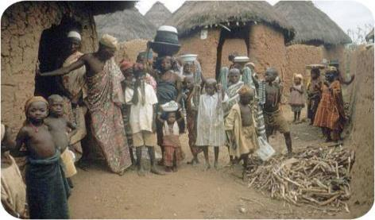

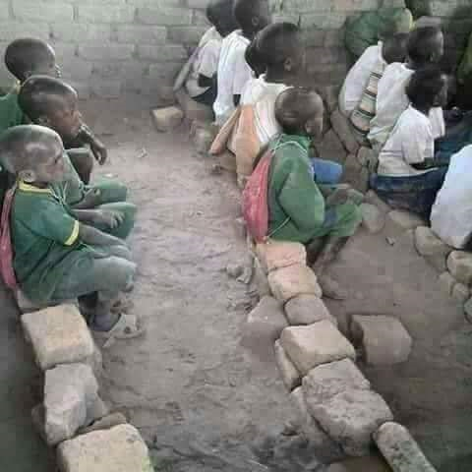

Effect of Corruption, Fraud and Money Laundering on the
Nigerian Financial System
Effect on Economic Development
01
Money laundering damages financial sector institutions that are critical for economic growth, promoting crime and corruption that slow economic growth, reducing efficiency in the real sector of the economy.
Effect on the Society
02
The possible social and political costs of money laundering, if left unchecked or dealt with ineffectively, are serious. Organised crime can infiltrate financial institutions, acquire control of large sectors of the economy through investment, or offer bribes to public officials and indeed governments.
Effect on Businesses
03
The integrity of the Businesses and financial services marketplace depends heavily on the perception that it functions within a framework of high legal, professional and ethical standards. A reputation for integrity is the one of the most valuable assets of a Business which is eroded by money laundering.
Effect of Corruption, Fraud and Money Laundering on Nigeria and its Financial System.

Slide 10
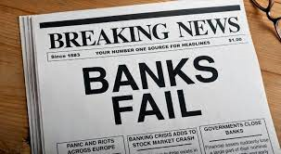


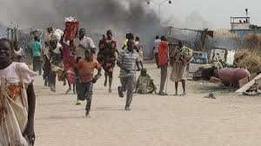
Effect of Corruption, Fraud and Money Laundering on the
Nigerian Financial System
Effect on Financial Institutions
04
Sudden changes may occur in the assets and liabilities of financial institutions that are unknowingly used in money laundering, which will create a risk for the institutions. The news of money laundering of these financial institutions which damages their reputation
Effect on Tax Revenues
05
Public revenues rely significantly on incomes and revenue from taxes. Money launderers evade tax payment which leads to reduction in Government revenues. If this income is low, it will raise the possibility that public revenues will not meet the public expenditures, and budget deficits will occur.
Increased criminality and insecurity
06
The rise of criminality is one major effect and a concern in money laundering. The success of money launderers is the distance they create between themselves and the criminal activity producing profit, so that they could enjoy the benefits of their crime without attracting attention and could also go to the extent of reinvesting the profits to finance other crimes.
Effect of Corruption, Fraud and Money Laundering on Nigeria and its Financial System.

Slide 11



Effect of Corruption, Fraud and Money Laundering on the
Nigerian Financial System
It undermine the Legitimate Private Sector
07
One of the most serious microeconomic impacts of money laundering, particularly in many developing countries like Nigeria, is felt in the private sector. Money launderers often use front companies, to fuse the proceeds of their illicit activities with legitimate funds, to hide their illicit proceeds.
Economic distortion and investment instability
08
Money launderers, in their quest to disguise the source of their ill-gotten proceeds, divert the proceeds from one economic venture to another without sound economic reasons. Also, as there is no motive to generate profits, money launderers, most often, invest their illicit funds in economic and commercial ventures that do not, primarily, benefit the economy of the country.
Posses Risks to Government Privatization efforts
09
The aim of privatization in many developing countries to promote economic growth, attracts money launderers who seizes the opportunity to acquire by purchasing into a previous government corporation by bidding higher prices for these corporations, a practice that undermines fair and legitimate competition.
Effect of Corruption, Fraud and Money Laundering on Nigeria and its Financial System.

Slide 12
Effect of Money Laundering on the Financial System
How Laundered Money could be judicious used
Amount of Looted and Laundered by and Individual | 5,700,000,000.00
Minimum Wage in Nigeria Per Month | 30,000.00
Minimum Wage in Nigeria Per Annum | 360,000.00
No. of People to Employ a Year | 15,833
Employ 15,833 Youth @ Monthly Stipend of N30, 0000.00 Monthly for a Year
Pay 95,000 Poor and Vulnerable Households @ Monthly Stipend of N5, 0000.00 Monthly
Give a Loan of N10,000.00 each to 47,500 Beneficiaries
Effect of Corruption, Fraud and Money Laundering on Nigeria and its Financial System.

Slide 13
How to reduce the effects of Money Laundering
on the Financial System
Establishment of Financial Intelligence unit (FIU) that serves as a National Centre for the receipt and analysis of: (a) suspicious transaction reports; and (b) other information relevant to money laundering, associated predicate offences and terrorist financing, and for the dissemination of the results of that analysis.
Financial Institutions should be required by laws to submit suspicious transactions reports (STRs) when it suspects or has reasonable grounds to suspect that funds are the proceeds of a criminal activity, or are related to money laundering, to report promptly its suspicions to the Financial Intelligence Unit (FIU) as well as other reports required by Law.
Financial institutions should be prohibited from keeping anonymous accounts or accounts in obviously fictitious names and required to undertake customer due diligence (CDD) measures when: establishing business relations, carrying out occasional transactions above the applicable designated threshold or there is a suspicion of money laundering
Designated law enforcement authorities should have responsibility for money laundering and terrorist financing investigations within the framework of national AML/CFT policies and they should develop a pro-active parallel financial investigation when pursuing money laundering, associated predicate offences and terrorist financing.
Effect of Corruption, Fraud and Money Laundering on Nigeria and its Financial System.

Slide 14
Conclusions and Recommendations
Curbing the menace of Money Laundering and associated predicate offences requires strong and effective collaboration and synergy between Reporting Entities, Competent Authorities and International Organisations.
1
Countries and all Stakeholders must ensure full compliance with International standards on combating Money Laundering and the Financing of Terrorism & Proliferation set by the Financial Action Task Force (FATF) as well as all domestic Laws and Regulations
2
Nigerian Financial Intelligence Unit (NFIU) as the focal Agency in the fight against Money Laundering and Terrorism Financing is poised to collaborate with all Stakeholders Local and International by providing credible and actionable Intelligence on Money Laundering Terrorism Financing.
3
Arms Proliferation
and Financing of
Arms Proliferation
Terrorism and
Financing of
Terrorism
Effect of Corruption, Fraud and Money Laundering on Nigeria and its Financial System.

Slide 15

Effect of Corruption, Fraud and Money Laundering on Nigeria and its Financial System.

Slide 16

Nigerian Financial Intelligence Unit
(NFIU)
No. 12, Ibrahim Taiwo Street, Aso Rock Villa, Abuja, FCT.
Visit our Website: www.nfiu.gov.ng
Send us Email: info@nfiu.gov.ng
Call us on: +2349097303256
Arms Proliferation
and Financing of
Arms Proliferation
Terrorism and
Financing of
Terrorism
Effect of Corruption, Fraud and Money Laundering on Nigeria and its Financial System.

Slide 17

Resources
1
Fatf-gafi.org. 2021. Money Laundering. [online] Available at: https://www.fatf-gafi.org/media/fatf/documents/recommendations/pdfs/FATF%20Recommendations%202012.pdf [Accessed 15 June 2021].
Fatf-gafi.org. 2021. Professional Money Laundering. [online] Available at: https://www.fatf-gafi.org/media/fatf/documents/Professional-Money-Laundering.pdf [Accessed 15 June 2021].
2
3
Sanction Scanner. Negative Effects of Money Laundering on The Economy. Retrieved June 13, 2021, from https://sanctionscanner.com/blog/negative-effects-of-money-laundering-on-the-economy-132 .
4
Ogbodo, U.K. & Mieseigha, E.G. (2013). The Economic Implications of Money Laundering in Nigeria. International Journal of Academic Research in Accounting, Finance and Management Sciences, 3(4), 170-184.
5
Sreekanth R. K. Basics of Indian Financial System. Retrieved June 15, 2021, from http://www.cvs.edu.in/upload/Basics-of-Indian-Financial-System.pdf .
6
Rose, Peter S. & Fraser, Donald R. & Kolari, James W. (1993). Financial institutions : understanding and managing financial services. Homewood, Ill : Irwin
7
Nigerian Financial Intelligence Unit: www.nfiu.gov.ng
7
Economic and Financial Crimes Commission - EFCC - https://www.efccnigeria.org

