Slide 1
Challenges of Nigeria’s anti-corruption laws/agencies and the role of the media in addressing them
By Dapo Olorunyomi
CEO of CJID
Represented by Idris Akinbajo
Managing Editor (Premium Times)

Slide 2
Posers
Is the absence of laws/sufficient legislation a hindrance to fighting corruption in Nigeria
Do/Should Nigerians agree on what constitutes corruption?
Should as much efforts be paid to preventing corruption as fighting it?
Should Nigeria (FG, States, LG, MDAs) design quantitative metrics to review impact of corruption policies?
Should we aim to eradicate corruption or simply try to minimize it with measurable indices

Slide 3
Posers (II)
Can we tackle corruption without a committed/efficient judiciary?
If essential, how do we get the kind of judiciary needed to tackle corruption?
Is the political will of a government/President sacrosanct to truly addressing corruption? Must the government see and state is as a malaise it wants to tackle?
Can we tackle corruption without addressing economic survival of the populace?
If corruption is truly endemic in Nigeria, how do we enable an ethical reorientation to reverse the trend.
What is the role of the media (journalists, bloggers, celebrities, Social Media, etc) in all of these?

Slide 4
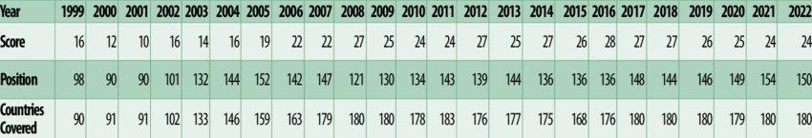
Good News?
Nigeria’s CPI: 16 (1999) 24 (2022)
Nigeria’s Position: 98 (1999) 150 (2022)
Garuba et al.

Slide 5
Problem still persists
“On average, bribe-payers pay an amount equivalent of up to 6% of the average annual income of Nigerians” – NBS, 2019
“…within the three years (2018 to 2020), Nigeria lost N2.9 trillion” to contract and procurement fraud – EFCC Chairman Olukoyede, Oct 2023

Slide 6
Nigeria’s many anti-graft laws
Nigerian Constitution
Corrupt Practices And Other Related Offences Act, 2000
Economic And Financial Crimes Commission (Establishment) Act, 2004
Code Of Conduct Bureau And Tribunal Act 2004
Nigeria Police Act, 2020
Nigerian Financial Intelligence Unit Act, 2018
Proceeds of Crime (Recovery and Management) Act, 2022
Terrorism (Prevention and Prohibition) Act, 2022

Slide 7
Nigeria’s many anti-graft laws (II)
Money Laundering (Prevention and Prohibition) Act, 2022
National Drug Law Enforcement Agency Act
The Miscellaneous Offences Act (MOA)
Advance Fee Fraud and Other Related Offences Act 2006
The Nigerian Extractive Industries Transparency Initiative Act
The Fiscal Responsibility Act 2010
AJCA
Evidence Act
Etc

Slide 8
Anti-corruption institutions/agencies
ICPC
EFCC
NFIU
CCB/CCT
NPF (SFU)
NDLEA
TUGAR
AuGF
PACAC
SPIP – now disbanded
Etc

Slide 9
Some govt policies to tackle corruption
IPPIS
GIFMIS
KYC
TSA
BVN
VOARS

Slide 10
Some CSO (efforts) tackling corruption
CISLAC
CBI
SEPAP
Leaks.ng
Udeme
CORA by AFRICMIL
Etc

Slide 11
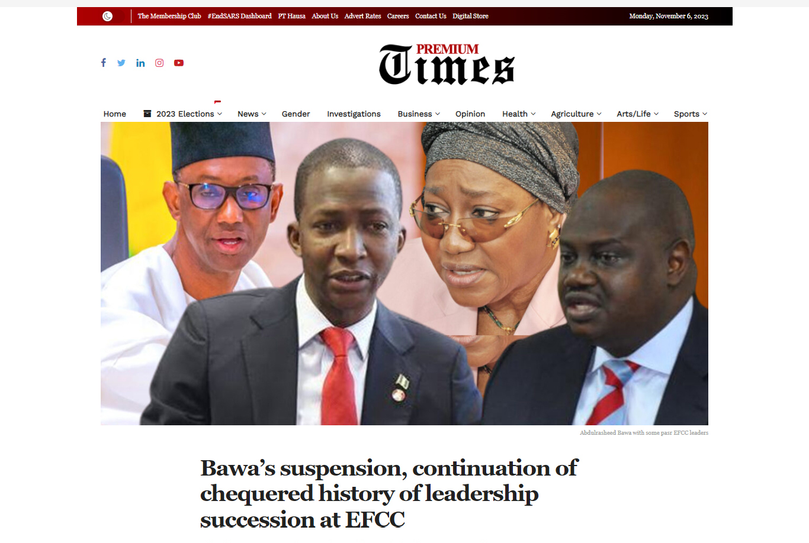
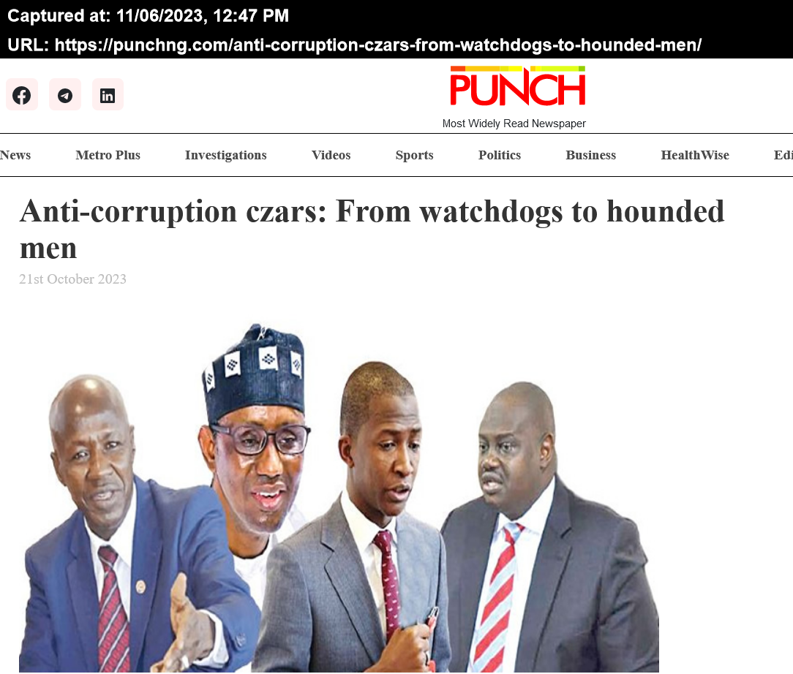
Some challenges of existing laws/institutions(1)
Removal of leadership (Section 3(2) of EFCC Act, Section 3(8) of ICPC Act, S5(4,5) of NFIU Act, CCB Section 1(4) etc).

Slide 12
Some challenges of existing laws/institutions (II)
Funding – All anti-corruption agencies/institutions complain of inadequate funding
Insufficient personnel (E.g. CCB and asset declaration forms)
Capacity Development
Collegiate nature of the ICPC (Section 4(2))
Anti-graft agencies having both investigative & prosecutorial powers
Constant tension between AGF and anti-graft agencies
Etc

Slide 13
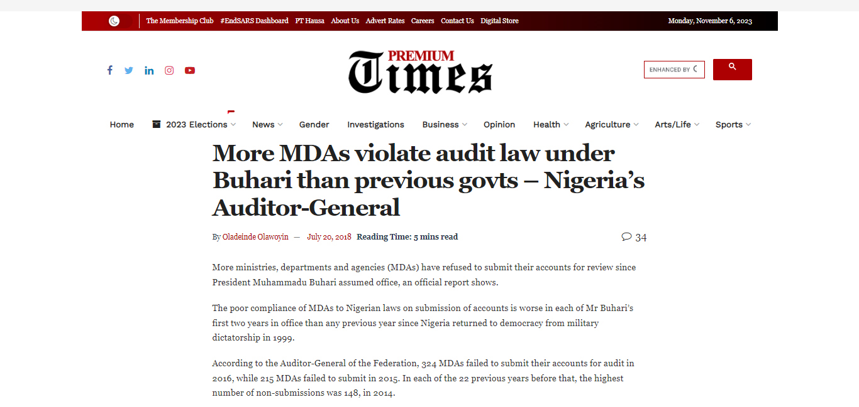
Some essential Amendments (1)
Nigeria Audit Service Bill should be signed into law (Not signed by Presidents Buhari and Tinubu and now back in NASS)

Slide 14
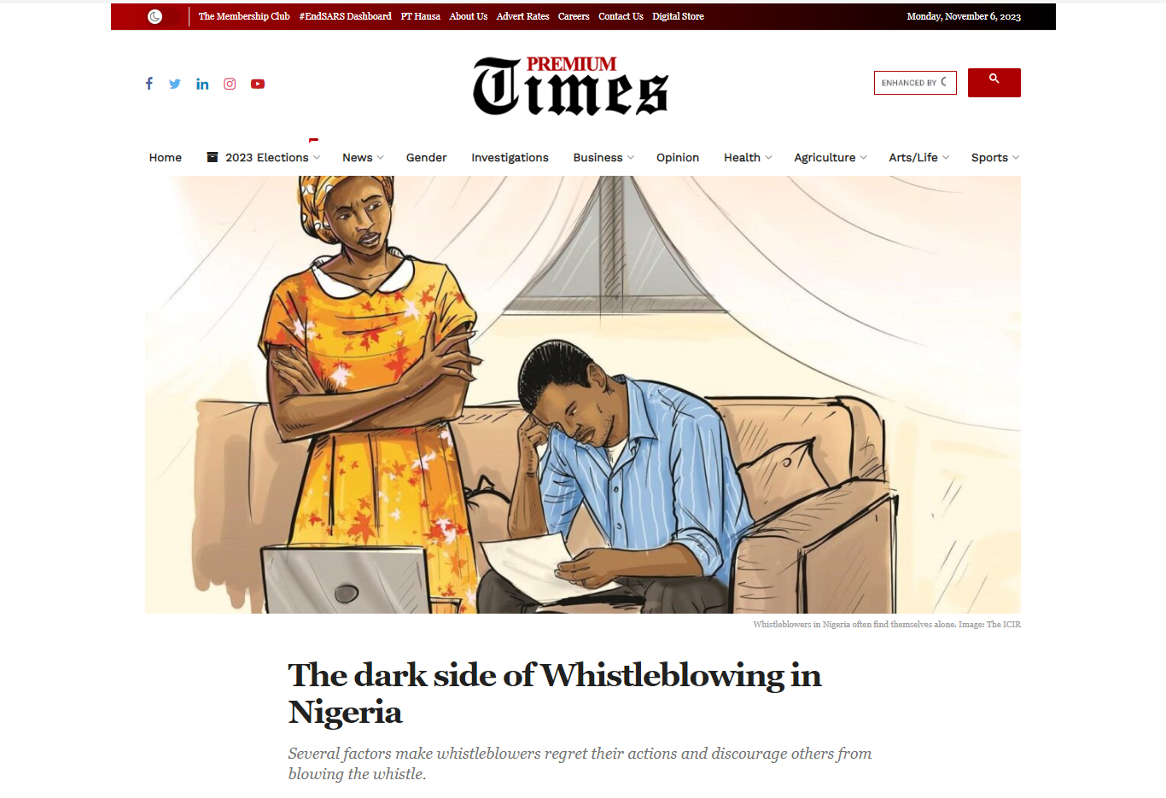
Essential Amendments (II)
Make CCB forms available to the public on request (Amendment of Paragraph 3c, third schedule of constitution)
Amend Money Laundering Act, Proceeds of Crime Act, etc, to allow recovery agencies keep certain percentage.
Pass Whistleblowing bill into law and strive to protect whisleblowers

Slide 15
Economic survival as panacea
The UNODC identifies 13 causes of public corruption.
Two of them (Wages, and failure of governance) are linked to economic survival
Make access to quality basic/essential amenities easy (education, healthcare, housing, transportation,…)

Slide 16
Corruption Prevention
EFCC – Fix Nigeria
ICPC – ACTU
Such systems should be incentivized and empowered
Metrics can be built/publicised around impact of corruption prevention efforts on MDAs

Slide 17
Investing in Ethics and Value System
Corruption has become endemic
Institutionalize ethics in all professional trainings/certifications
Review/Adoption of value systems and deliberate efforts to incentivize ethical conducts
Consider the creation of an anti-corruption academy
Use mass media (SM, celebrities, journalists,…) to deliberately propagate values

Slide 18
Judiciary’s role in anti-corruption war
Only the judiciary can convict a corrupt person
Controversial/Ridiculous court judgments (eg: Perpetual injunctions, technicalities over substance, etc)
Review of mode of appointment of judges
Need for anti-corruption courts and progressive anti-corruption judges
Etc

Slide 19
Political Will!!!
If a government does not see corruption as a fundamental problem, why should it invest in tackling it?
Strong political will needed to tackle official corruption, especially by top officials
Only an anti-corruption minded government with strong political will would be willing to relinquish its control over appointment/removal of heads of anti-graft agencies
Even a non-corrupt executive leadership still has to deal with (corrupt) lawmakers, judiciary, civil service…
Is it realistic to expect liberal democracy in a society like Nigeria to throw up a strong-willed anti-corruption leadership?

Slide 20
Role of the Media
Media(Journalism) Democracy
Four Journalism roles (Disseminator, Adversarial; Public mobiliser; Watchdog)
Constitutional role of Accountability Journalism (S22- Nigeria; S162(5) – Ghana; S11 – Sierra Leone; S15 – Liberia; etc)

Slide 21
Specific roles of media
Inform the public better on the limitations/successes of anti-graft agencies and the reasons for such
Provide more information/clarity on deficiencies in laws and need for amendment
Always highlight violations of anti-graft laws and its impact on the anti-corruption fight
Name and shame public officials found culpable in violating anti-graft laws
Tell better/more stories on impact of corruption on ordinary people
Collaborate with CSOs focused on/have expertise on corruption war
Integrate ethical journalism within newsrooms/among journalists including in journalism trainings
Help electorate understand the effect of electing corrupt officials to power in a democracy.

Slide 22


