Slide 1
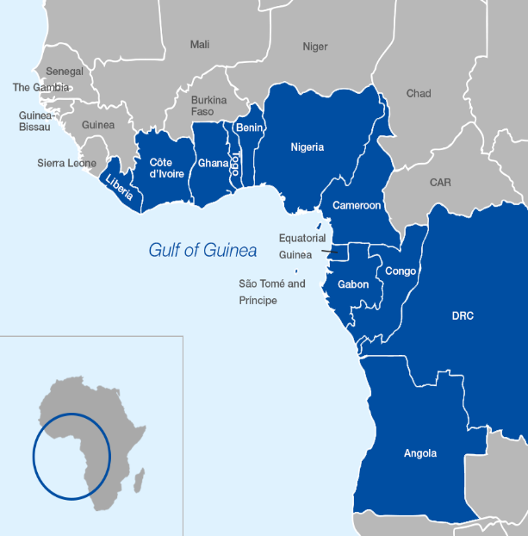

Current Trends in Trafficking in Persons in Nigeria: Effects on Socio- Economic Development of Nigeria
BY
Abosede g. iheabunike, esq.
ASST. DIRECTOR (LEGAL AND PROSECUTION )
NATIONAL AGENCY FOR THE PROHIBITION OF TRAFFICKING
IN PERSONS (NAPTIP)
A PRESENTATION AT A 3-DAY WORKSHOP
HELD AT NICON LUXURY HOTELS
7TH -9TH NOVEMBER, 2023

Slide 2

PRESENTATION OUTLINE
INTRODUCTION
OVERVIEW OF TRAFFICKING AND SMUGGLING IN AFRICA
  DRIVERS OF TRAFFICKING AND SMUGGLING IN AFRICA
  FORCED MIGRATION
NIGERIA’S PERSPECTIVE
  NAPTIP MODEL (GOOD PRACTICES FROM NAPTIP)
CONCLUSION
National Agency for the Prohibition of Trafficking in Persons (NAPTIP)
…Ensuring a human trafficking-free nation

Slide 3
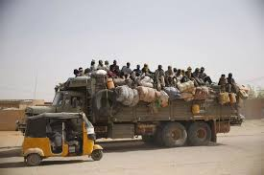
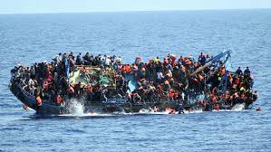


INTRODUCTION
  WHAT IS MIGRATION?
  Migration is the movement of people from one place to another with the intention of settling, permanently in the new location; in pursuit of economic prospects, educational advancement, family reunion, etc.
  Migration is as old as man; hence it is said that mobility is inherent in human existence.
  By Road
  By Sea
  By Air
National Agency for the Prohibition of Trafficking in Persons (NAPTIP)
…Ensuring a human trafficking-free nation
Notes:
Dimensions of Transnational Crime include; Crime against international law, Crime against humanity, Crime against peace, War Crime

Slide 4
INTRODUCTION
  OVERVIEW ON MIGRATION:
In 2000, the US Population Division reported that almost 175 million people, representing about 2.9% of the world’s population, were living outside their countries of birth for more than a year.
In 2015, the UN reported that international migrants globally reached 244 million, which is a 41 per cent increase compared to 2000.
  World Bank Fact Sheet (2017) estimates that over 266 million people globally live outside their countries of origin; and out of this figure, over 20 million from sub-Saharan Africa according to the report, showing that mobility is inherent in human existence.
  It is estimated that by 2050, at the current rate there would be 405 million international migrants globally
National Agency for the Prohibition of Trafficking in Persons (NAPTIP)
…Ensuring a human trafficking-free nation
Notes:
Dimensions of Transnational Crime include; Crime against international law, Crime against humanity, Crime against peace, War Crime

Slide 5
INTRODUCTION
  FORMS OF MIGRATION:
  Legal Migration; describes where the migrant goes through the legal process of obtaining all authentic travel documents.
  Illegal Migration, also called Irregular Migration can be seen as movement that takes place outside the regulatory norms of the sending, transit and receiving countries.
  Irregular migration gives birth to migration crisis and encourages modern day slavery
  Irregular Migration manifests in two major forms which both constitute criminal offences (trans-border crimes).
  Trafficking in Persons (TIP) and
  Smuggling of Migrants (SOM)
  These two related transnational organized crimes also result in the violation of fundamental human rights.
National Agency for the Prohibition of Trafficking in Persons (NAPTIP)
…Ensuring a human trafficking-free nation

Slide 6
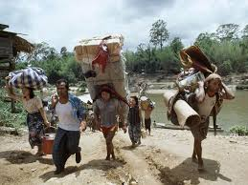
INTRODUCTION
DEFINITIONS
The United Nations Protocol to Prevent, Suppress and Punish Trafficking in Persons, especially Women and Children, supplementing the United Nations Convention against Transnational Organized Crime defines Trafficking as:
“The recruitment, transportation, transfer, harbouring or receipt of persons by means of threat or use of force or other forms of coercion, of abduction, of fraud, of deception, of abuse of power or of a position of vulnerability or of giving or receiving of payment or benefit to achieve the consent of a person having control over another person for the purpose of exploitation.”
National Agency for the Prohibition of Trafficking in Persons (NAPTIP)
…Ensuring a human trafficking-free nation
Notes:
Dimensions of Transnational Crime include; Crime against international law, Crime against humanity, Crime against peace, War Crime

Slide 7
INTRODUCTION
Elements of Trafficking and Smuggling Actors
ACT – recruitment, transportation, harbouring, or receipt of a person
MEANS – threat or use of force, coercion, abduction, fraud, deception, abuse of power or vulnerability, or giving payments or benefits to a person in control of victim
The Act
The Means
The Purpose
TIP
PURPOSE – exploitation (includes exploitation of prostitution of others, sexual, forced labour, slavery or similar practices and removal of organs
Coordinator/
Organizer
Recruiters
Transporters/
Guides
Spotters/
Messengers/
Informants
Service
Providers/
Suppliers
Actors in Smuggling of Migrants
Notes:
Dimensions of Transnational Crime include; Crime against international law, Crime against humanity, Crime against peace, War Crime

Slide 8
INTRODUCTION
Common Features
Both are transnational organized crimes
Differences
Consent
Transnationality &
Source of profit
It is generally noteworthy to state that what may begin as a smuggling operation can quickly transform into human trafficking.
Transnational crime refers to those self-perpetuating associations of individuals who operate transnationally for the purpose of obtaining power, influence, monetary and/or commercial gains, wholly or in part by illegal means, while protecting their activities through a pattern of corruption and/ or violence, or while protecting their illegal activities through a transnational organizational structure as well as the exploitation of transnational commerce or communication mechanisms.
National Agency for the Prohibition of Trafficking in Persons (NAPTIP)
…Ensuring a human trafficking-free nation
Notes:
Dimensions of Transnational Crime include; Crime against international law, Crime against humanity, Crime against peace, War Crime

Slide 9
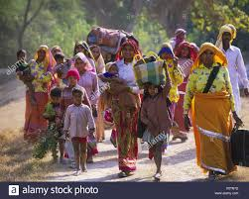
OVERVIEW OF SMUGGLING AND TRAFFICKING IN AFRICA
Modern day slavery thrives in most African countries as the region consists essentially of developing countries.
Most African countries are affected by the crime as either countries of origin, transit or destination.
Human Trafficking in Africa, especially of Women and Children is facilitated by the socioeconomic and cultural climate of the region, with child labour being widely accepted.
National Agency for the Prohibition of Trafficking in Persons (NAPTIP)
…Ensuring a human trafficking-free nation
Notes:
Dimensions of Transnational Crime include; Crime against international law, Crime against humanity, Crime against peace, War Crime

Slide 10
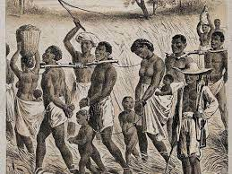
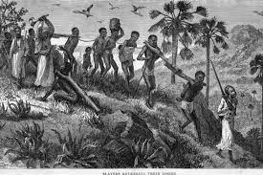
OVERVIEW OF SMUGGLING AND TRAFFICKING IN AFRICA
Africa was notable for the pre-historic account of human beings sold into slavery as a result of war, debt bondage, and other exploitative reasons. This was before the advent of the Trans-Atlantic Slave Trade.
Slavery and the slave trade that followed thereafter were an integral part of African societies and States which supplied the Arab world with enslaved people for centuries, before the arrival of the Europeans.
The transatlantic slave trade was the trading, primarily of African people to the colonies of the then New World that occurred in and around the Atlantic Ocean.
National Agency for the Prohibition of Trafficking in Persons (NAPTIP)
…Ensuring a human trafficking-free nation
Notes:
Dimensions of Transnational Crime include; Crime against international law, Crime against humanity, Crime against peace, War Crime

Slide 11
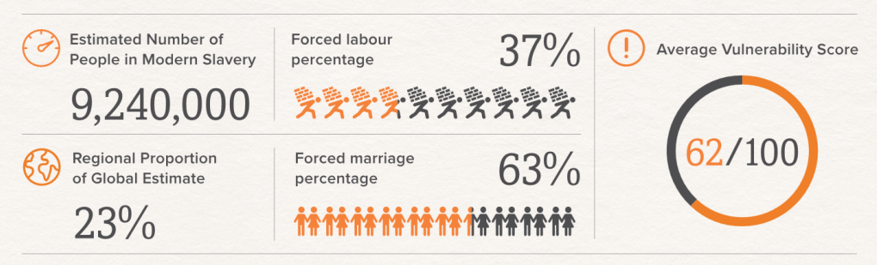
OVERVIEW OF SMUGGLING AND TRAFFICKING IN AFRICA
9.2 Million Africans are victims of modern day slavery as of 2016 and 23% of the total global modern day slavery population in Africa are engaged in forced labour, forced marriages and sexual exploitation
(BORGEN MAGAZINE)
Source: Global Slavery Index, 2018
National Agency for the Prohibition of Trafficking in Persons (NAPTIP)
…Ensuring a human trafficking-free nation
Notes:
Dimensions of Transnational Crime include; Crime against international law, Crime against humanity, Crime against peace, War Crime

Slide 12
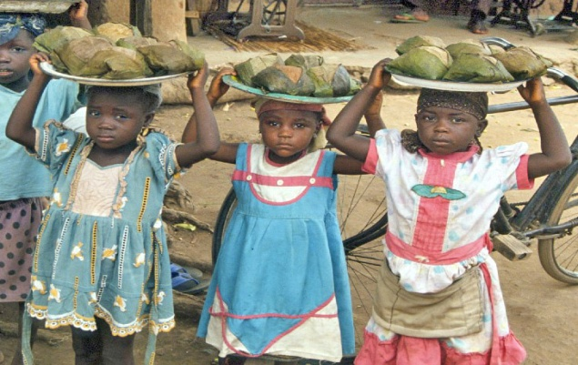
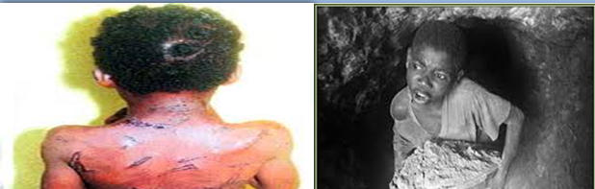
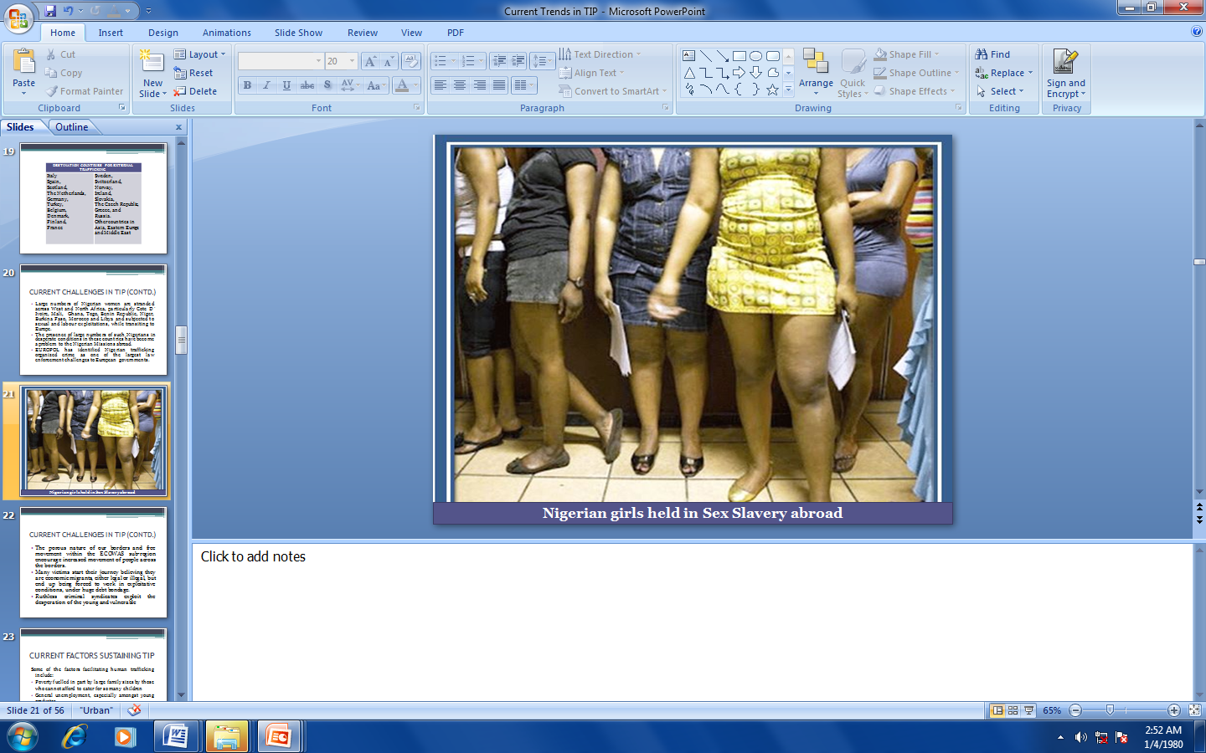
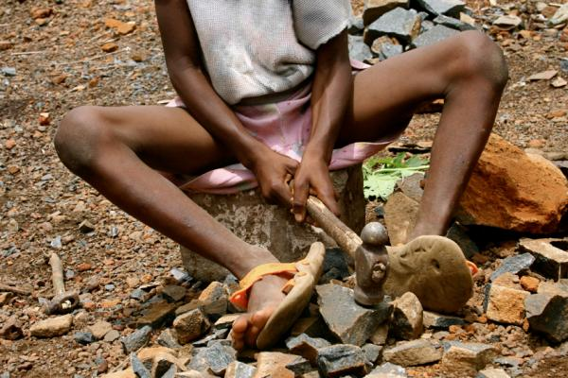

OVERVIEW OF MIGRATION AND TRAFFICKING IN AFRICA
The most common forms of slavery in sub-Saharan Africa are forced labour and forced marriage
Africa accounts for 8% of child sex trafficking in the world.
National Agency for the Prohibition of Trafficking in Persons (NAPTIP)
…Ensuring a human trafficking-free nation
Notes:
Dimensions of Transnational Crime include; Crime against international law, Crime against humanity, Crime against peace, War Crime

Slide 13
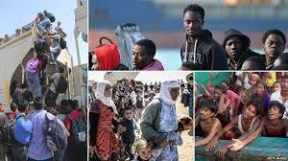
DRIVERS OF SMUGGLING AND TRAFFICKING IN AFRICA
THE CONECPT OF GREEN PASTURES
Human Traffickers and Smugglers prey on the vulnerability of their Victims and their socioeconomic conditions to perpetrate their wicked acts: hence offering them false promises of better economic prospects abroad.

Slide 14
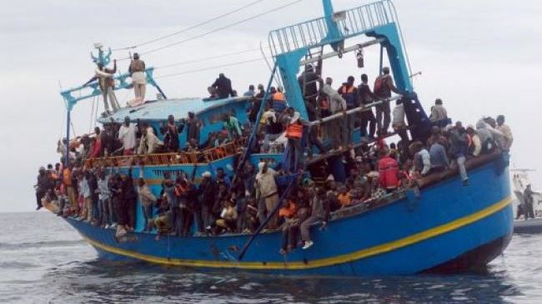
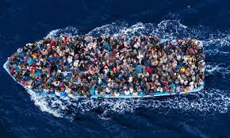
THE CONECPT OF GREEN PASTURES
Victims of irregular migration are most times so desperate that they can use any means; they only realize that these are all false at their destination when they face the reality of the myths.

Slide 15
NIGERIA’S PERSPECTIVE
  Nigeria like many other African countries is a Source, transit and destination country for both Migration and human trafficking.
External trafficking basically for sexual and labour exploitation, usually in young persons and women
Internal trafficking for sexual and labour exploitation, Domestic servitude, child labour.
Recruitment predominantly features deceit, debt bondage, abduction, oaths and threats
The trend is rural-urban flow; with Lagos, Kano and FCT as major destinations as illustrated in the graphics below:
National Agency for the Prohibition of Trafficking in Persons (NAPTIP)
…Ensuring a human trafficking-free nation

Slide 16
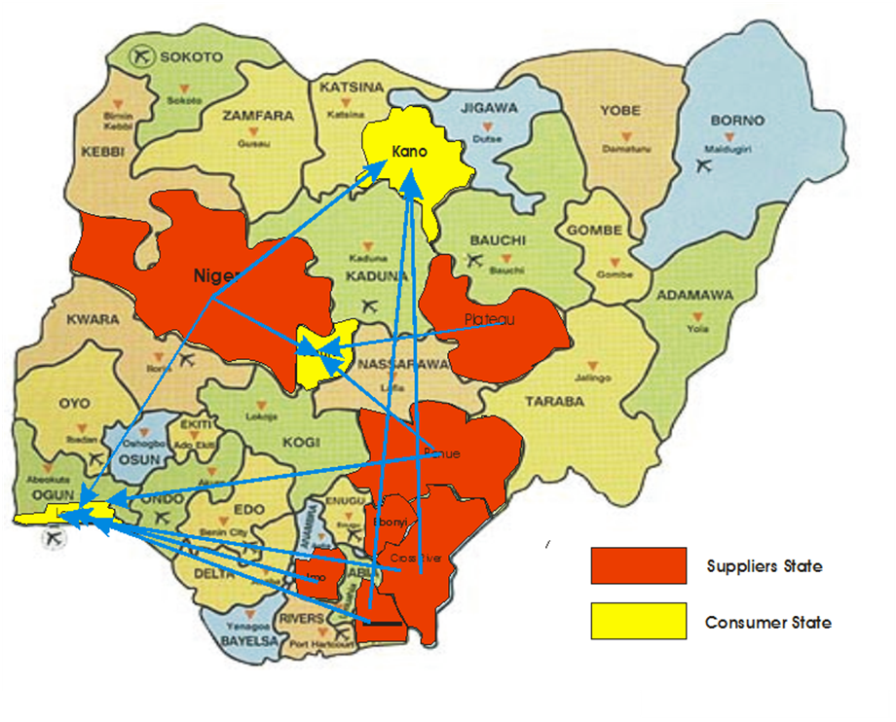
NIGERIA’S PERSPECTIVE
The trend of internal migration in Nigeria shows mainly Rural to Urban with major cities as destination locations
Migration Routes within Nigeria
National Agency for the Prohibition of Trafficking in Persons (NAPTIP)
…Ensuring a human trafficking-free nation

Slide 17
CURRENT TRENDS IN TIP IN NIGERIA
Organ and Tissue Harvesting
Orphanage Trafficking
Sextortion
Sport related trafficking
Trafficking for domestic labour

Slide 18
NIGERIA’S PERSPECTIVE
NATIONAL RESPONSE TO TRAFFICKING
LEGAL AND INSTITUTIONAL RESPONSE:
Nigeria enacted its Anti-trafficking legislation in 2003, amended same in 2005 and then repealed and re-enacted the Trafficking in Persons Prohibition Enforcement and Administration Act, in 2015.
Nigerian government also established NAPTIP in 2003 and vested it with legal and institutional powers as the focal Agency against trafficking in persons
National Agency for the Prohibition of Trafficking in Persons (NAPTIP)
…Ensuring a human trafficking-free nation
Notes:
Dimensions of Transnational Crime include; Crime against international law, Crime against humanity, Crime against peace, War Crime

Slide 19
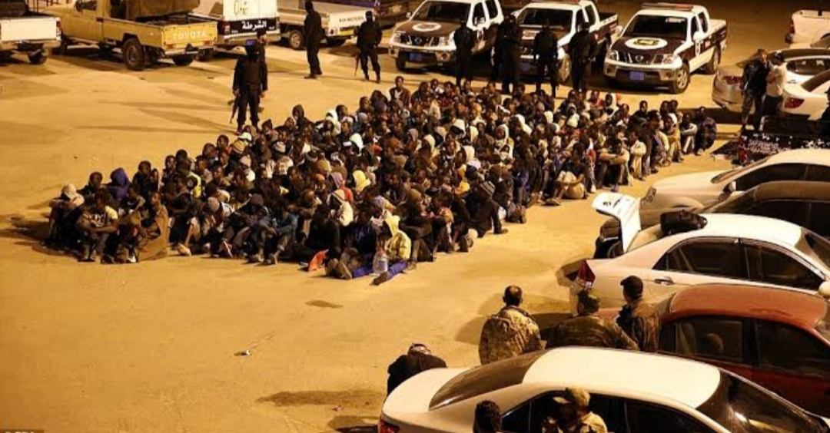
NIGERIA’S PERSPECTIVE
NATIONAL RESPONSE TO TRAFFICKING AND SMUGGLING
Assisted Return: Over the years, Nigerian government has been working with IOM and other stakeholders towards the return of Nigerian Migrants in various countries abroad.
Currently, following some reports about Nigerian migrants trapped in exploitative camps in other African countries and beyond, there is an ongoing evacuation in several batches, of Nigerian nationals from Libya, Mali, etc.
National Agency for the Prohibition of Trafficking in Persons (NAPTIP)
…Ensuring a human trafficking-free nation
Notes:
Dimensions of Transnational Crime include; Crime against international law, Crime against humanity, Crime against peace, War Crime

Slide 20
CONSEQUENCES OF IRREGULAR MIGRATION/TRAFFICKING
IMPLICATIONS ON NATIONAL DEVELOPMENT:
Provides huge wealth to the criminal sub-culture abroad hence undermining development of home country
Leads to other crimes which portends a threat to national security
Fuels corruption among public officers
Fuels irregular immigration which is a security threat
Tarnishes the international reputation of a country
National Agency for the Prohibition of Trafficking in Persons (NAPTIP)
…Ensuring a human trafficking-free nation

Slide 21
CONSEQUENCES OF IRREGULAR MIGRATION/TRAFFICKING
IMPLICATIONS ON SOCIAL AND ECONOMIC DEVELOPMENT:
Impedes human capital development of the sending nation by depleting its workforce
Results in the spread of deadly diseases
Results in the death of key family members such as breadwinners, hence exposing the family to extreme poverty
Reduction of the nation’s active Population
Destroys international relations which impedes international trade/investments
National Agency for the Prohibition of Trafficking in Persons (NAPTIP)
…Ensuring a human trafficking-free nation

Slide 22

CONSEQUENCES OF HUMAN TRAFFICKING
THE HUMAN COST:
• Physical health:
• Malnutrition
• Exposure to sexually transmitted diseases, including HIV/AIDS
• Possible unwanted pregnancies and forced abortions
• Infections and infectious diseases due to unhygienic conditions, overcrowding, lack of access to clean water
• Hazardous working conditions may affect the growth of a child
Suicide among others
• In addition to these impacts, victims of trafficking often suffer from stigmatization
National Agency for the Prohibition of Trafficking in Persons (NAPTIP)
…Ensuring a human trafficking-free nation

Slide 23
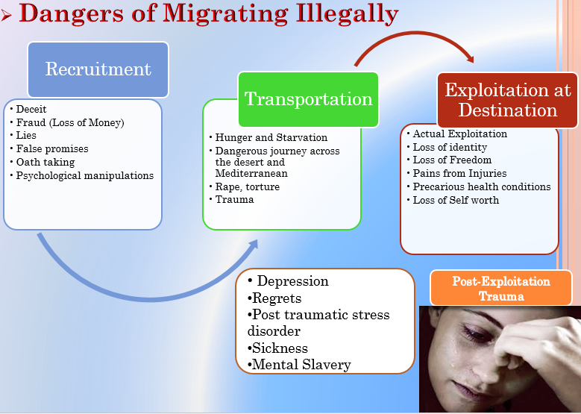
DANGERS OF TRAFFICKING/SMUGGLING
There are dangers in all the stages of human trafficking

Slide 24
NAPTIP’S MODEL
NAPTIP’s 5 Ps Approach
Policy
Prevention
Protection
Prosecution
Partnership
National Agency for the Prohibition of Trafficking in Persons (NAPTIP)
…Ensuring a human trafficking-free nation

Slide 25
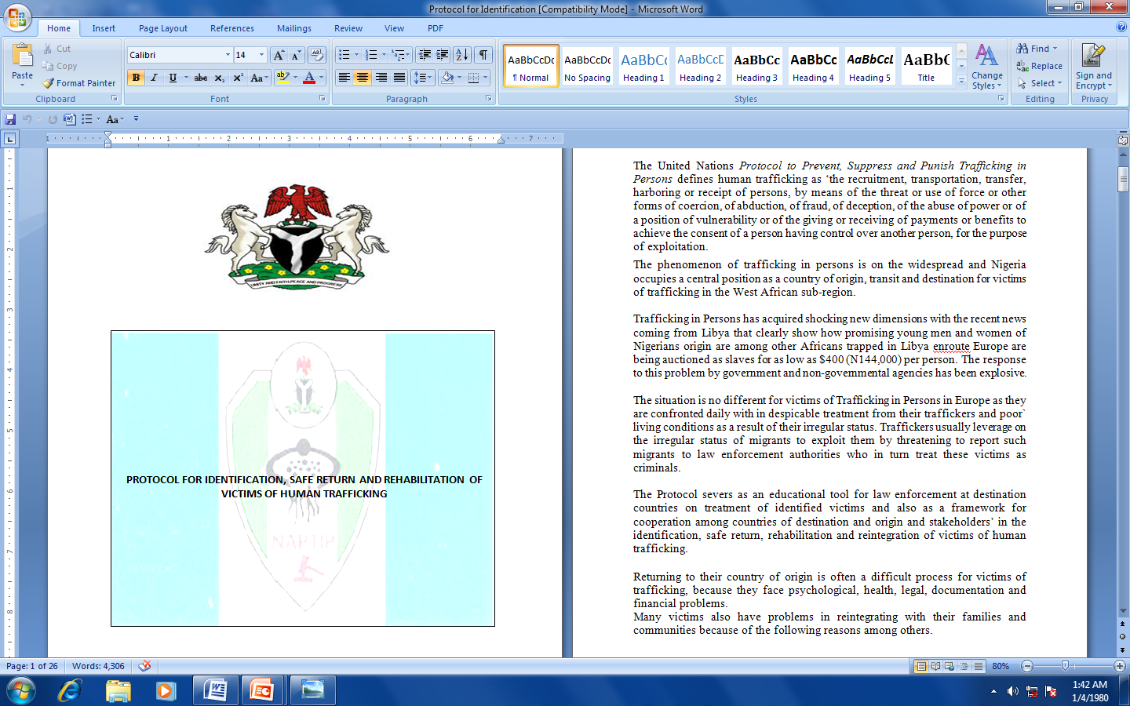
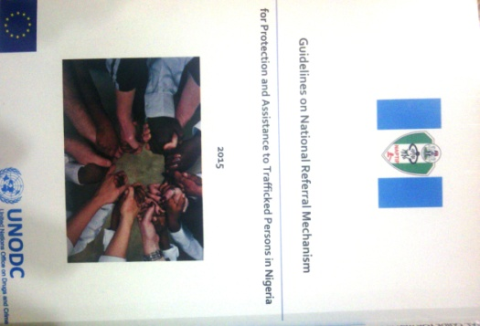
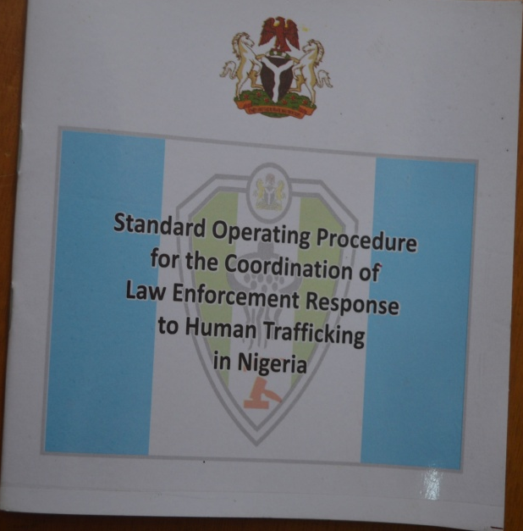
NAPTIP’S MODEL
Policy
Development and Implementation of Policies towards the prevention, suppression and elimination of Human Trafficking
National Agency for the Prohibition of Trafficking in Persons (NAPTIP)
…Ensuring a human trafficking-free nation

Slide 26
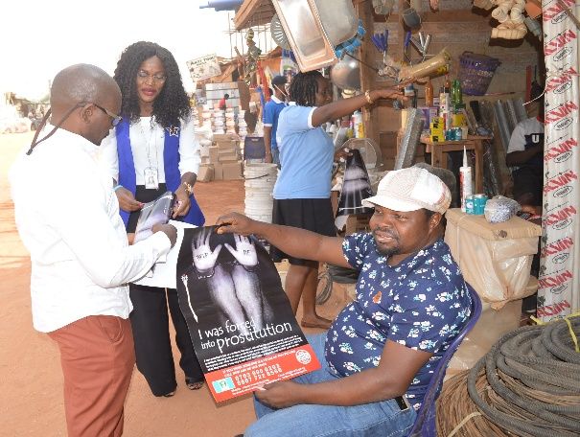
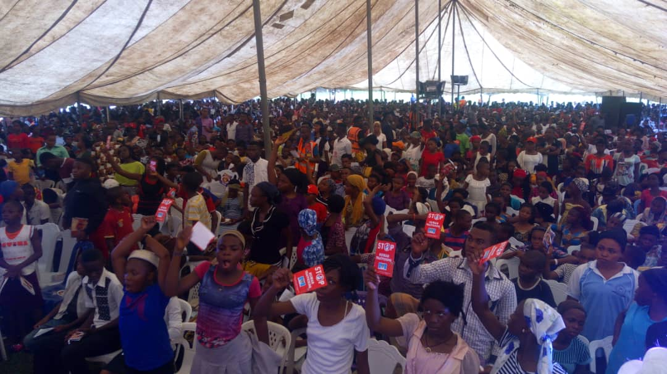
NAPTIP’S MODEL
PrEVENTION
National Agency for the Prohibition of Trafficking in Persons (NAPTIP)
…Ensuring a human trafficking-free nation

Slide 27
NAPTIP’S MODEL
PrOTECTION of the victims of the crime through the provision of protection services such as sheltering, counseling, rehabilitation, empowerment, medical, legal, etc.
Policy Documents on Victim Protection:
National Policy on Protection and Assistance to Trafficked Persons
Guidelines for the Protection of Children in Formal Care
Guidelines on National Referral Mechanism for Victims of Trafficking
Protocol for Identification, Safe Return and Rehabilitation of Victims etc
National Agency for the Prohibition of Trafficking in Persons (NAPTIP)
…Ensuring a human trafficking-free nation
Notes:
The Enabling Law of NAPTIP contains ample provisions on the protection of identity of victims of trafficking. It also has safeguards on the social rights of the victim.

Slide 28

NAPTIP’S MODEL
PrOSECUTION of human traffickers to get justice for the crime victims, punish offenders and to serve as deterrent to others.
Documents on Prosecution:
Standard Operating Procedure for Investigation and Prosecution of Trafficking in Persons in Nigeria
Standard Operating Procedure for the Coordination of Law Enforcement Response to Trafficking in Persons in Nigeria
National Agency for the Prohibition of Trafficking in Persons (NAPTIP)
…Ensuring a human trafficking-free nation
Notes:
In prosecuting the offenders, the enabling law of the Agency also empowers the Agency to undertake asset forfeiture of human traffickers

Slide 29

NAPTIP’S MODEL
PARTNERSHIP with all relevant stakeholders including civil society, local and international partners, state and non-state actors towards the detection and elimination of the crime
Instruments for Coordinating Partnership:
National Stakeholders Forum on TIP, convened 24 times
National/Zonal/State/Local Government Working Groups
State Taskforces on Human Trafficking (20 inaugurated)
National Plan of Action Against Human Trafficking (2021 – 2025 at an advanced stage of development.
National Agency for the Prohibition of Trafficking in Persons (NAPTIP)
…Ensuring a human trafficking-free nation
Notes:
The Agency enjoys a good degree of assistance from numerous partners, including UN Agencies, Embassies and relevant stakeholders in Law Enforcement.

Slide 30
CONCLUSION
All countries are affected by the crime of human trafficking and irregular migration. Nigeria is not an exception.
These two crimes portend devastating consequences on human, national and international security
With the active collaboration of all stakeholders at regional, national and subnational levels as well as stronger legislative and policy frameworks, transnational crimes can be reduced to the barest minimum
National Agency for the Prohibition of Trafficking in Persons (NAPTIP)
…Ensuring a human trafficking-free nation

