Slide 1


Day 3

Slide 2

5th Annual Conference on Financial Fraud, Cross-Border Crime & Illicit Substance Abuse
Tunji Aworinde MSc, MBA FCCA CEO Forensic Insight International Ltd
Abuja.Lagos.London www.theforensicinsight.com
Tel +234 8149 44 4660 Tel +234 9081 21 2881 Tel +44 (0) 20 7821 2874
November 10 – 12, 2020

Slide 3
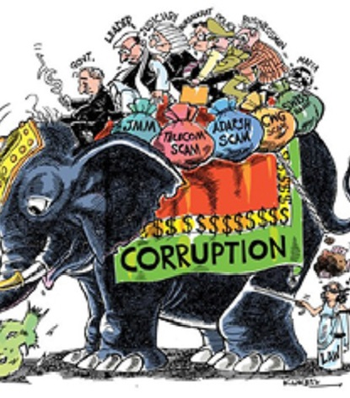
Why Nigeria
The emergence of multinational “looting Machines’ is not unusual in oil producing and mineral rich nations, but Nigeria is exceptional in producing unimaginable number of criminals able to participate successfully in global illicit markets. Why is Nigeria special in this regard?
(The Present Darkness – S Ellis)

Slide 4
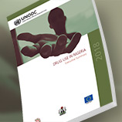

Nigeria, EU and UNODC release first-ever National Drug Use Survey
Abuja, Nigeria, 29 January 2019 - The number of drug users in Nigeria is estimated at 14.4 per cent or 14.3 million people aged between 15 and 64 years according to the results of the National Drug Use Survey released today in Abuja. The data suggests that the prevalence of past year drug use in Nigeria is more than twice the global average of 5.6 per cent. Why is Nigeria special in this regard?

Slide 5
Making a statement (and resolve that we know the difference)
Our nation’s problems are
man-made; therefore they
may be solved by man. No
problem of human destiny is
beyond human solution’
RIGHT & WRONG
GOOD & BAD
DAY & NIGHT
(J F Kennedy 10/06/1963)

Slide 6
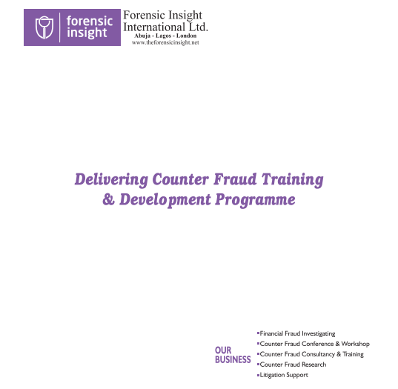
Contribution to anti-corruption campaign,
Capacity Building
Ethical
Recommendation
Visit www.theforensicinsight.com
Counter Corruption Training Academy

Slide 7
  Thank You

